Slide 1
ECON 672
Week 5: Panel Data and Fixed Effects (Within) Estimator
Samuel Rowe, PhD 12/22/2022

Slide 2
Overview
Takeaway
Fixed Effects DAG
Estimation
Pooled OLS
Fixed Effects or Within Estimator
Caveats of Fixed Effects
Example

Slide 3
The Takeaway
Panel Data
When we observe the same $i^{th}$ unit over time
With cross-sectional data, we do not observe the same $i^{th}$ over time
We can use the panel structure to control for unobserved or observed time-invariant heterogeneity
Time-invariant heterogeneity (observed or unobserved) are covariates that vary across units but do not vary within units
Fixed Effects (Within) Estimator
Is an identification strategy that can be employed with panel data
It works when we have unobserved time-invariant confounders

Slide 4
Takeaway (Fixed Effects)
Strengths
We can control for unobserved confounders that do not vary over time with panel data and the fixed effects estimator
Weaknesses
We cannot control for unobserved confounders that do vary over time
We cannot control for simultaneity or reverse causation
Assumptions
Strict Exogeneity Assumption (Independence Assumption - not testable)
Rank Assumption (covariates must vary - testable)

Slide 5
Directed Acyclic Graphs: Panel Data

Slide 6
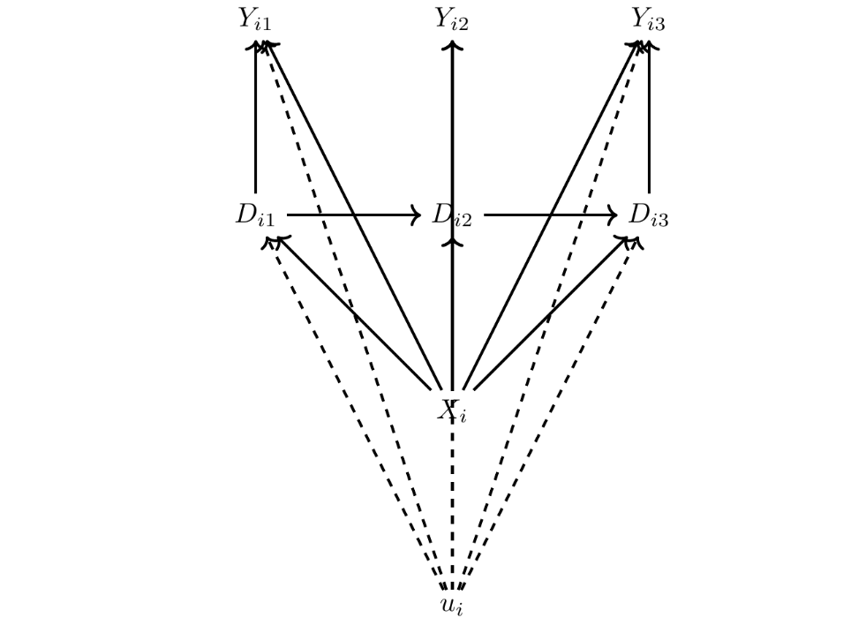
Directed Acyclic Graphs: Panel Data

Slide 7
Directed Acyclic Graphs: Panel Data
The most complex DAG yet
$D_{it}$ can vary over time
$$D_{i1}→D_{i2}$$
$$D_{i2}→D_{i3}$$
$Y_{it}$ can vary over time
$$D_{i1}→Y_{i1}$$
$$D_{i2}→Y_{i2}$$
$$D_{i3}→Y_{i3}$$

Slide 8
Directed Acyclic Graphs: Panel Data
$D_{it}$ affects $Y_{it}$ and $D_{i(t+1)}$
$$Y_{it}←D_{it}→D_{i(t+1)}$$
We assume that outcomes are not affected by prior outcomes
$$Y_{it}⊥Y_{i(t+1)}$$
We assume that prior treatment does not affect current outcomes directly, but mediated
$D_{it}→D_{i(t+1)}→Y_{i(t+1)}$

Slide 9
Directed Acyclic Graphs: Panel Data
$X_{i}$ are observed confounders that do not vary over time
$u_{i}$ are unobserved confounders that do not vary over time
$D_{it}$ and $Y_{it}$ have t in the subscripts and $X_{i}$ and $u_{i}$ do not
This means that D and Y vary over time and X and u are time-invariant

Slide 10
Directed Acyclic Graphs: Panel Data
Given that $X_{i}$ and $u_{i}$ are time-invariant
$$Y_{it}←X_{i}→D_{it}$$
$$Y_{it}←-u_{i}-→D_{it}$$
$X_{i}$ and $u_{i}$ are time-invariant confounders that affect treatment and outcome in every period

Slide 11
Directed Acyclic Graphs: Panel Data
Under this scenario, we can use the Fixed Effects (Within) Estimator
The Fixed Effects (Within) Estimator closes all of the confounding backdoors that do not vary over time
Note: if u varied over time, then the Fixed Effects (Within) Estimator would not close all backdoor pathways

Slide 12
Panel Data Estimators
Panel data refers to data where an unit of observation (individual, firm, county, etc.) is observed longitudinally or over time (more than one time period)
If observed or unobserved confounders do not vary across time for a unit (but vary across units)
We can use panel data to identify the causal effect
Estimators with Panel Data
Pooled OLS
Fixed Effects (Within) Estimator
First-differencing (not our focus)
Random Effects Estimator (requires special assumption and not our focus)

Slide 13
Notation
We will utilize traditional notation instead of potential outcomes for panel data
Let Y and D be random variables
Where $D≡D(D_{i},D_{2},...,D_{k})$
Let u be an unobserved random variable
We are interested in the partial effect of $D_{j}$ from
$$E[Y|D_{1},D_{2},...,D_{k},u]$$

Slide 14
Notation
We observe a sample $i=1,2,...,N$ cross-sectional units for $t=1,2,...,T$ time periods, which is a a balanced panel (no missing observations in matrix)
Cross-sectional independence: individuals in the panel are identical and independent draws from the population $\{Y_{i},D_{i},u_{i}\}_{i=1}^{N}∼i.i.d$
$Y=\left[\begin{matrix}Y_{11} & Y_{21} & ⋯ & Y_{N1} \\ Y_{12} & Y_{22} & ⋯ & Y_{2N} \\ ⋮ & ⋮ & ⋱ & ⋮ \\ Y_{1T} & Y_{2T} & ⋯ & Y_{NT}\end{matrix}\right]$ and $D=\left[\begin{matrix}D_{11} & D_{21} & ⋯ & D_{N1} \\ D_{12} & D_{22} & ⋯ & D_{2N} \\ ⋮ & ⋮ & ⋱ & ⋮ \\ D_{1T} & D_{2T} & ⋯ & D_{NT}\end{matrix}\right]$

Slide 15
Regression Notation
$Y_{it}=δD_{it}+u_{i}+ε_{it}$ is our unobserved effects model
Where $Y_{it}$ is our outcome of interest for $i=1,2,...,N$ over $t=1,2,...,T$
$δ$ is our treat effect of interest
$D_{it}$ is our treatment for $i=1,2,...,N$ over $t=1,2,...,T$
$u_{i}$ is the sum of all time-invariant person-specific characteristics, such as ability
$ε_{it}$ is the idiosyncratic error - includes unobserved time-varying covariates

Slide 16
Pooled OLS
Pooled OLS is the simplest panel data estimator
It does not account for the panel structure
$$Y_{it}=δD_{it}+η_{it};t=1,2,...,T$$
Where the composite error
$$η_{it}≡u_{i}+ε_{it}$$
Where $u_{i}$ is time-invariant heterogeneity
$ε_{it}$ is time-varying heterogeneity
We need to assume that $u_{i}$ is does not impact $D_{it}$ for all time periods

Slide 17
Pooled OLS
In order to identify the causal effect with Pooled OLS
We need to show that
$$E[η_{it}|D_{i1},D_{i2},...,D_{iT}]=E[η_{it}|D_{it}]=0∀t=1,2,...,T$$
TL;DR
We need to ignore omitted variable bias, which is unlikely to work well
This is likely not a credible assumption

Slide 18
Fixed Effects (Within) Estimator
The Fixed Effects (FE) Estimator is also called the Within Estimator
It accounts for the variation within a unit of observation over time
The FE estimator will does a better job of controlling for observed and unobserved time-invariant confounders

Slide 19
Fixed Effects (Within) Estimator
Our unobserved effects model
$$Y_{it}=δD_{it}+u_{i}+ε_{it}$$
We think of our fixed effect $u_{i}$ as a covariate to be estimated
The OLS estimation for $\overset{̂}{δ}$ and $\overset{̂}{u_{i}}$ under minimizing sum of squared (over i and t)
$$(\overset{̂}{δ},\overset{̂}{u_{1}},\overset{̂}{u_{2}},...,\overset{̂}{u_{N}})=\underset{b,m_{1},...,m_{N}}{argmin}\overset{N}{\underset{i=1}{∑}}\overset{T}{\underset{t=1}{∑}}(Y_{it}-D_{it}b-m_{i})^{2}$$
This means we include $N$ number of individual dummy variables in the regression of $Y_{it}$ on $D_{it}$

Slide 20
Fixed Effects (Within) Estimator
We’ll use our two first order conditions
Recall that $E[u|x]=0$ and $E[ux]=0$
$$\overset{N}{\underset{i=1}{∑}}\overset{T}{\underset{t=1}{∑}}D_{it}^{′}(Y_{it}-D_{it}\overset{̂}{δ}-{\overset{̂}{u}}_{i})=0$$
$\overset{T}{\underset{t=1}{∑}}(Y_{i}t-D_{it}\overset{̂}{δ}-{\overset{̂}{u}}_{i})=0$ for $i=1,2,...,N$

Slide 21
Fixed Effects (Within) Estimator
Therefore, for $i=1,2,...,N$
$${\overset{̂}{u}}_{i}=\frac{1}{T}\overset{T}{\underset{t=1}{∑}}(Y_{it}-D_{it}\overset{̂}{δ})={\overline{Y}}_{i}-{\overline{D}}_{i}\overset{̂}{δ}$$
Where ${\overline{D}}_{i}≡\frac{1}{T}\overset{T}{\underset{t=1}{∑}}D_{it}$ and ${\overline{Y}}_{i}≡\frac{1}{T}\overset{T}{\underset{t=1}{∑}}Y_{it}$
Plug in the results into the first first-order condition: $\overset{N}{\underset{i=1}{∑}}\overset{T}{\underset{t=1}{∑}}D_{it}^{′}(Y_{it}-D_{it}\overset{̂}{δ}-{\overset{̂}{u}}_{i})=0$

Slide 22
Fixed Effects (Within) Estimator
$$\overset{̂}{δ}=\frac{∑_{i=1}^{N}∑_{t=1}^{T}(D_{it}-{\overline{D}}_{i})^{′}(Y_{it}-{\overline{Y}}_{i})}{∑_{i=1}^{N}∑_{t=1}^{T}(D_{it}-{\overline{D}}_{i})^{′}(D_{it}-{\overline{D}}_{i})}=\frac{∑_{i=1}^{N}∑_{t=1}^{T}{\overset{··}{D}}_{it}^{′}{\overset{··}{Y}}_{it}}{∑_{i=1}^{N}∑_{t=1}^{T}{\overset{··}{D}}_{it}^{′}{\overset{··}{D}}_{it}}$$
Where ${\overset{··}{D}}_{it}≡D_{it}-{\overline{D}}_{i}$ and ${\overset{··}{Y}}_{it}≡Y_{it}-{\overline{Y}}_{i}$
Recall $\overset{̂}{δ}=\frac{C(Y,D)}{V(D)}$

Slide 23
Fixed Effects (Within) Estimator
TL;DR
Using time-demeaned variables ${\overset{··}{D}}_{it}≡D_{it}-{\overline{D}}_{i}$ and ${\overset{··}{Y}}_{it}≡Y_{it}-{\overline{Y}}_{i}$ is equivalent to a regression of $Y_{it}$ on $D_{it}$ with unit-specific dummy variables
This is why it is called the Within Estimator, since we are utilizing the variation within a specific-unit
When we include unit-specific fixed effects and year-specific fixed effects, this is called the “two-way fixed effects” estimator
We’ll cover this later

Slide 24
Fixed Effects (Within) Estimator
Using time-demeaned variables, the time-invariant confounders zeros out
Time-invariant confounders do not vary, such that $E[c]=c$
Demeaning eliminates time-invariant observed and unobserved confounders, such that $u_{i}-{\overline{u}}_{i}=0$
$$Y_{it}=δD_{it}+u_{i}+ε_{it}$$
Demean across $T$: $(Y_{it}-{\overline{Y}}_{i})=(δD_{it}-δ{\overline{D}}_{i})+(u_{i}-{\overline{u}}_{i})+(ε_{it}-{\overline{ε}}_{it})$
$${\overset{··}{Y}}_{it}=δ{\overset{··}{D}}_{it}+{\overset{··}{ε}}_{it}$$

Slide 25
Implement Fixed Effects
There are three ways that we can implement fixed effects in our regression
1) Demean and regression ${\overset{··}{Y}}_{it}$ on ${\overset{··}{D}}_{it}$ (and need to correct for degrees of freedom)
2) Regress $Y_{it}$ on $D_{it}$ and unit-specific dummy variables (dummy variable regression)
3) Regress $Y_{it}$ on $D_{it}$ with canned fixed effects routine in Stata or R

Slide 26
Assumptions
There are a couple of necessary identifying assumption we need in order for the Fixed Effects (Within) Estimator to identify the causal effect
Strictly exogenous assumption (independence assumption and not testable)
$E[ε_{it}|D_{i1},D_{i2},...,D_{iT},u_{i}]=0$ for $t=1,2,...,T$
Rank assumption (variation is required for at least some units and is testable)
$$rank(\overset{K}{\underset{t=1}{∑}}E[{\overset{··}{D}}_{it}^{′}{\overset{··}{D}}_{it}])=K$$
Recall that this is just the $V(D_{it})$ from $\overset{̂}{δ}=\frac{C(Y_{it},D_{it})}{V(D_{it})}$

Slide 27
Assumptions
Our strict exogeneity assumption will be similar to our independence assumption
Our time-invariant confounders can be related to $D_{it}$ since we control for them with fixed effects
We need to be concerned about unobserved time-varying confounders, which will violate this assumption
Our rank assumption requires that there be variation in treatment over time for at least some units of observation
Otherwise it will be 0 and violate the assumption

Slide 28
Assumptions
If our two main assumption hold, then the fixed effects estimator identifies the causal effect
The fixed effect estimate is consistent $(\underset{N→∞}{plim}{\overset{̂}{δ}}_{FE,N}=δ)$ and unbiased
This holds as long as the number of clusters is large enough
This will be an issue we’ll run into with Diff-in-Diff

Slide 29
Caveats of Fixed Effects (Within) Estimator
There are two key caveats we need to be aware of
1) Fixed effects cannot resolve reverse causality
$$Y→D$$
2) Fixed effects cannot control for time-varying unobserved confounders
We have to assume that there are no time-varying unobserved confounders
$E[ε_{it}|D_{i1},D_{i2},...,D_{iT},u_{i}]=0$ for $t=1,2,...,T$

Slide 30
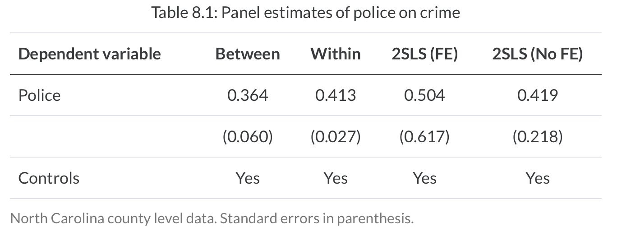
Caveats
Fixed Effects Estimator cannot handle reverse causality
Cornwell and Trumbell (1994) find positive correlations between policing and crime rates using panel data from North Carolina

Slide 31
Caveats
Does this mean that police cause more crime?
It is likely a reverse causality problem and they did not identify the causal effect
Police spending is a function of crime rates and crimes rates
Simultaneity bias is creating bias for their estimated treatment effects
Becker (1986) predicts the police spending per capita will theoretically reduce crime
What is the relationship between the outcome, treatment, and covariates of interest?

Slide 32
Caveats
We need to assume no time-varying unobserved confounders
The presence of any time-varying unobserved confounders will prevent the backdoor criterion from being satisfied
This is just omitted variable bias
You will need another research design to handle time-varying unobserved confounders
Demean time-varying confounder is just moved to the composite error term and the strict exogeneity assumption (independence assumption) is violated

Slide 33
Example: Returns to Marriage
Cornwell and Rupert (1997) attempt to estimate the returns to marriage on earnings
The SDO shows that married men earn more than unmarried men
The SDO is likely biased from confounders and selection into marriage
We’ll use panel data estimators to see the returns to marriage
What does the Feasible Generalized Least Squared model compared to Fixed Effects?

Slide 34
Example: Returns to Marriage
Let’s set up the model for individuals $i$ observed over four periods $t$
$$Y_{it}=α+δM_{it}+βX_{it}+A_{i}+γ_{i}+ε_{it}$$
Where
$Y_{it}$ is earnings for individual $i$ earnings in time period $t$
$M_{it}$ is the outcome of interest and $δ$ is our treatment effect of interest
$X_{it}$ is a set of observable covariates for individual $i$ earnings in time period $t$
$A_{i}$ is unobserved time-invariant ability for individual $i$
$γ_{i}$ is unobserved time-invariant confounders for individual $i$
$ε_{it}$ is our idiosyncratic error or unobserved determinants of wage that are assumed to be unrelated to $M_{it}$

Slide 35
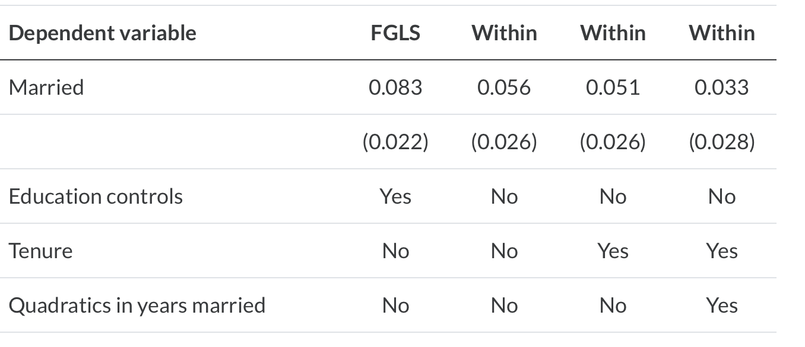
Example: Returns to Marriage

Slide 36
Example: Returns to Marriage
Cornwell and Rupert (1997) find that the Feasible Generalized Least Squares model is upward biased
After controlling for time-varying covariates, such as education, tenure, and years of marriage
The treatment effect is not statistically significant

Slide 37
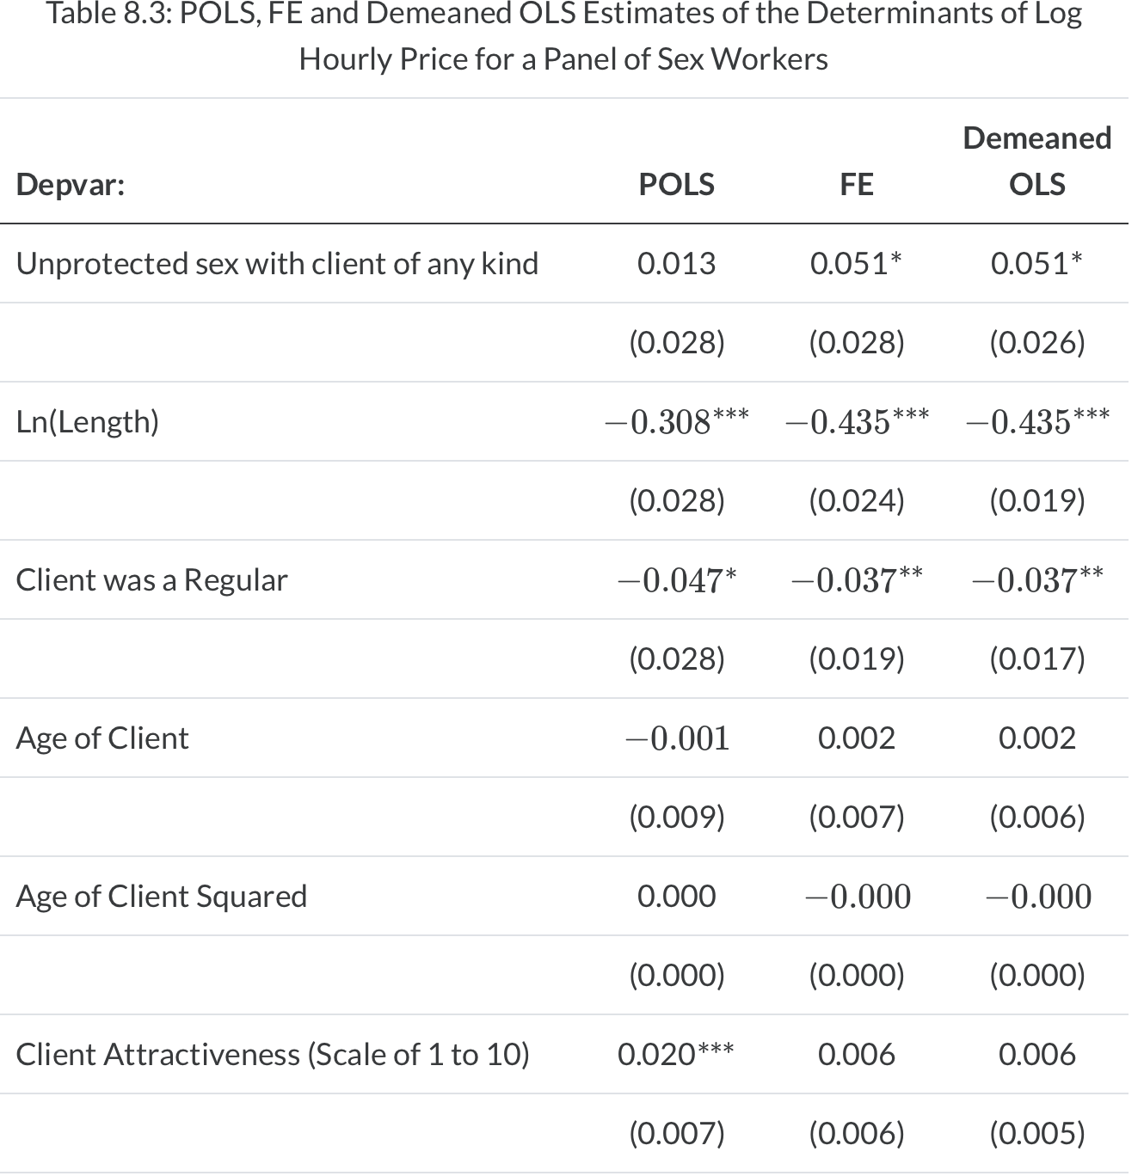
Example
Stata Exercise (Cunningham and Kendall, 2011, 2014, 2016)

Slide 38
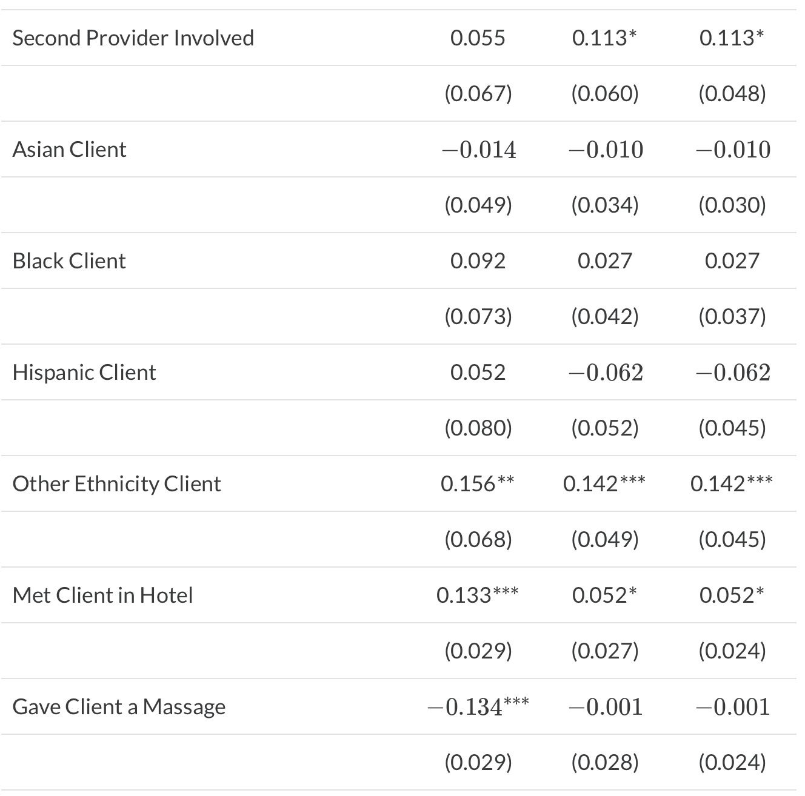
Example
Stata Exercise (Cunningham and Kendall, 2011, 2014, 2016)

Slide 39
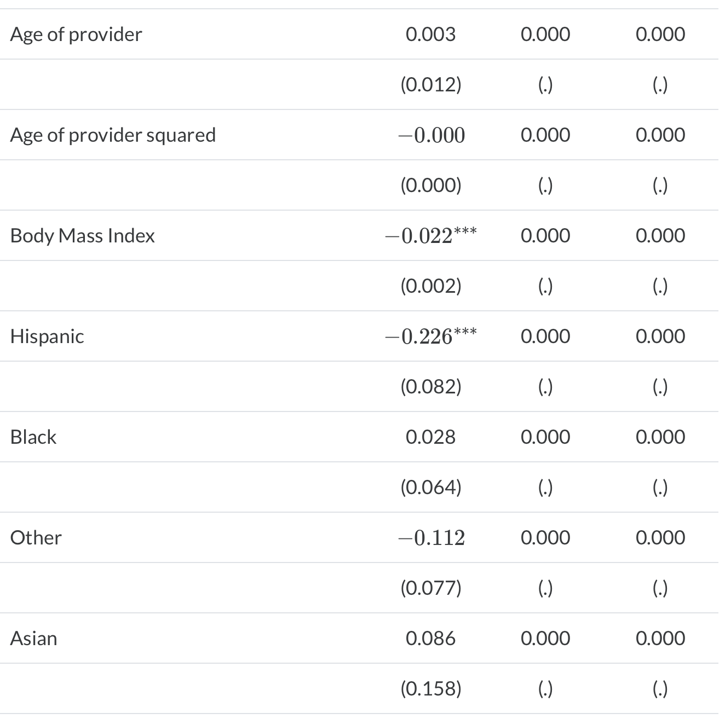
Example
Stata Exercise (Cunningham and Kendall, 2011, 2014, 2016)

Slide 40
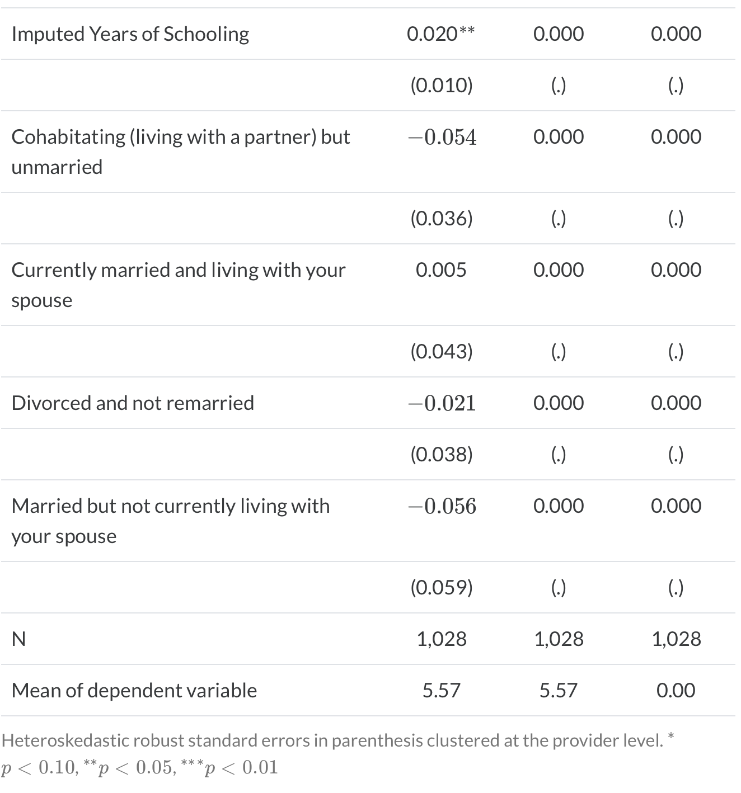
Example
Stata Exercise (Cunningham and Kendall, 2011, 2014, 2016)

Slide 41
Concluding Remarks
Fixed Effects (Within) Estimator can be a powerful tool
May not be utilized enough in federal evaluations
Unlike PSM, fixed effects can control for some unobservable confounders
As long as
1) There are no time-varying confounders, you have a straight-forward methodology that can identify the causal effect
2) There is no reverse causality
This will require an instrumental variable strategy

